Slide 1

PANCREAS SEGMENTATION IN ABDOMINAL CT SCAN USING U-NET
SANJAY KRISHNAAN H 312317205119
SARAVANA PRASHANTH K 312317205121
UNDER GUIDANCE OF
Mrs. P.Thilakavathy M.E.

Slide 2
OBJECTIVE:
The main objective is to facilitate the pancreatic image segmentation in a CT scan.
This system can help the traditional methodology of image segmentation manually and increase the accuracy of the prediction and segmentation of Pancreas from CT scan.
To provide a much more clear sense to the patient and help them understand the scan image properly.
To help medical students understand the anatomy of human stomach and other regions around the pancreas

Slide 3
Abstract:
A CT scan involves taking a series of X-rays from different angles to show clear images of the bones and soft tissues, including organs in the abdomen.
It can help reveal any abnormalities in the pancreas or the area around it.
To segment the pancreas and to provide a clear view of it is the primary concern of the project.
Gray scale image filter followed by masking of images to train the model is done in the primary image processing steps.
It is followed by enumeration of the data into pixel encoded array list and training the model with U-NET architecture.
Finally, the pancreas is segmented using mask images and testing of data is done with the saved model.

Slide 4
Literature survey:
S.NO | AUTHOR, TITLE, AND YEAR | METHODOLOGY | ADVANTAGES | DISADVANTAGES
1. | Dr. Bindhu V. BIOMEDICAL IMAGE ANALYSIS USING SEMANTIC SEGMENTATION, 2019. | The proposed method utilizes the AlexNet as the encoder module and affixes the decoder module with transpose convolutional layers to up-sample the feature maps to the full–resolution segmentation map. | The biomedical segmentation produces a very high performance with the rational amount of training epochs at a rational training time. | The down-sample and up-sample method reduces the image resolution which might affect the accuracy of the segmentation.
2. | Ozan Oktay, Jo SchlemperLoic Le, Folgoc Matthew, LeeMattias Heinrich. Attention U-Net Learning Where to Look for the Pancreas, 2018. | Convolutional neural networks outperform traditional approaches in medical image analysis on public benchmark datasets while being an order of magnitude faster than, e.g., graph-cut and multi-atlas segmentation techniques. | AGs can benefit from transfer learning and multi-stage training schemes. | Efficiency can be improved only by introducing 3D models which requires more GPU computation power and memory.

Slide 5
Literature survey: [ cont. ]
S.NO | AUTHOR, TITLE, AND YEAR | METHODOLOGY | ADVANTAGES | DISADVANTAGES
3. | Dr. Olaf Ronneberger Mr. Philipp Fischer and Dr. Thomas Brox. U-Net: Convolutional Networks for Biomedical Image Segmentation, 2015. | Displayed the results on the segmentation of neuronal structures in EM stacks and performed the network of Ciresan. Furthermore, shows results for cell segmentation in light microscopy images from the ISBI cell tracking . | It works with a large margin on the two most challenging 2D transmitted light datasets. | Requires lot of annotated training samples
4. | Ange Lou, Shuyue Guan, Murray Loew. DC-U Net: Rethinking the U-Net Architecture with Dual Channel Efficient CNN for Medical Image Segmentation, 2020. | Designed efficient CNN architecture to replace encoder and decoder and to improve state-of-the-art U-Net model. Choosing U-Net as baseline model and pre-processing the images also doing binary classification. | Dual Channel CNN is more efficient than traditional U-NET CNN architecture. | U-Net and MultiRes-UNet tend to under-segment and even miss the objects completely.

Slide 6
Literature survey: [ cont. ]
S.NO | AUTHOR, TITLE, AND YEAR | METHODOLOGY | ADVANTAGES | DISADVANTAGES
5. | Jun Gao, Qian Jiang, Bo Zhou, Daozheng Chen. Convolutional neural networks for computer-aided detection or diagnosis in medical image analysis, 2019. | CNN-based methods are actively used for tasks such as localization, segmentation and registration in medical image analysis. The performance is evaluated by various metrics such as F1-score, recall, TPR, FPR, dice-coefficient. | They can be effectively used to deal with limited training data. | Large volume of training and test data makes the model storage expensive and longer processing time.
6. | Holger R. Roth, Amal Farag, Le Lu, Evrim B. Turkbey, and Ronald M. Summers. Deep convolutional networks for pancreas segmentation in CT imaging, 2015. | This generates a super pixel for all local images in the training set. Data augmentation is done to increase the diversity of data. Conv-Net probabilities is converted to 3D smoothed Conv-Net probabilities in order to generate slight variations that are physically plausible. | Conv-Nets have a better chance of capturing the “essence” of the imaging data set used for training than when using hand-crafted features. | Since main focus is on pancreas segmentation other organ segmentation's efficiency is comparatively low.

Slide 7
Literature survey: [ cont. ]
S.NO | AUTHOR, TITLE, AND YEAR | METHODOLOGY | ADVANTAGES | DISADVANTAGES
7. | Dr.S.Kannan, Vairaprakash Gurusamy, G.Nalini. Review on Image Segmentation Techniques, 2015. | Image segmentation is the fundamental step to analyze images and extract data from them. Algorithm is based on two properties similarity and discontinuity. | Provides a clear explanation and atomic viewpoint on image segmentation techniques. | Fails to explain the modern methodologies of image segmentation.
8. | Rina Komatsu and Tad Gonsalves. Effectiveness of U-NET in Denoising RGB images, 2019. | Digital images often contain “noise” which takes away their clarity and sharpness. CNN based architecture “U-NET” is trained here to remove different kinds of noise while leaving their features and other details intact. | The Process and applications of U-NET architecture are discussed in detail and provides a brief description of it. | The different layers, optimizers and loss functions can be described better in detail.

Slide 8
Literature survey: [ cont. ]
S.NO | AUTHOR, TITLE, AND YEAR | METHODOLOGY | ADVANTAGES | DISADVANTAGES
9. | Jonathan Long, Evan Shelhamer, Trevor Darrell. Fully Convolutional Networks for Semantic Segmentation, 2011. | Fully Convolutional Networks take input of arbitrary size and produce output with efficient inference. Defined skip architecture to produce accurate and detailed segmentations. | Fully CNN can efficiently learn to make dense predictions. | Heavy load of training and test data is required for accurate and detailed segmentation.
10. | Pedro M.Sosa. Twitter Sentiment Analysis using Combined LSTM-CNN Models, 2017. | Combine CNN and LSTM networks to do sentiment analysis on twitter data. CNN-LSTM model reached higher accuracy when compared to other traditional models. | This combination of network model provides higher accuracy and less time required for training and testing the model. | This is not applicable for complex tasks.

Slide 9
Existing system:
The existing segmentation pipeline consists of three stages, namely coarse, fine, and refine stages.
A coarse segmentation is obtained through multi-atlas based 3D diffeomorphic registration and fusion.
To learn the connection feature, a 3D patch-based CNN and three 2D slice-based CNNs are jointly used to predict a fine segmentation based on a bounding box determined from the coarse segmentation.
A 3D level-set method is used, with the fine segmentation being one of its constraints, to integrate information of the original image and the CNN-derived probability map to achieve a refine segmentation.
It jointly utilize global 3D location information (registration), contextual information (patch-based 3D CNN), shape information (slice-based 2.5D CNN) and edge information (3D level-set) in the proposed framework.
These components form their cascaded coarse-fine-refine segmentation framework.

Slide 10
DRAWBACKS OF Existing system:
Lack of accuracy in derived data and pre-processed data streams for the model to process.
More man power required on the field to collect CT images and time consuming without heavy GPU power.
The CT Scan images were rescaled to smaller dimensions and scales. Thus the accuracy of the system took a hit and though the size was reduced, it still consumes a large volume of storge and makes it an expensive system.
Needs manual calculations on some unscaled images and High diversity and error in assessment of the image is to be expected due to human errors.

Slide 11
PROPOSED WORK:
In our proposed system, we provide a fast accessible model which processes the CT scan image and provide the display result output in a stipulated time, much faster than the provided current system.
The raw image from the CT scan is pre-processed by a image processing algorithm and stored in a folder. The folder is later split into train, test, and validation sets for the deep learning model.
Later the train image set is passed through a multi-layered Convolutional neural network, set in the architecture of U-Net model. The images is the set are annotated and trained to develop a sustained model.
Furthermore, the model is presented for testing phase with the test set folder, the test efficiency and accuracy is calculated.
Finally, the model undergoes validation phase and the segmented pancreas image from an abdominal CT Scan is displayed as the output.

Slide 12
ADVANTAGES OF PROPOSED WORK:
The U-Net model is a specific model developed for medical image segmentation and a light weight model. It can process through the images faster than other stable Deep Learning Architecture models.
The space complexity of the U-Net architecture model is much less than the compared model.
The data processing stage provides a better advantage to provide well segregated and annotated image for the model to process.
The accuracy of the proposed system is slightly greater than the existing system.

Slide 13
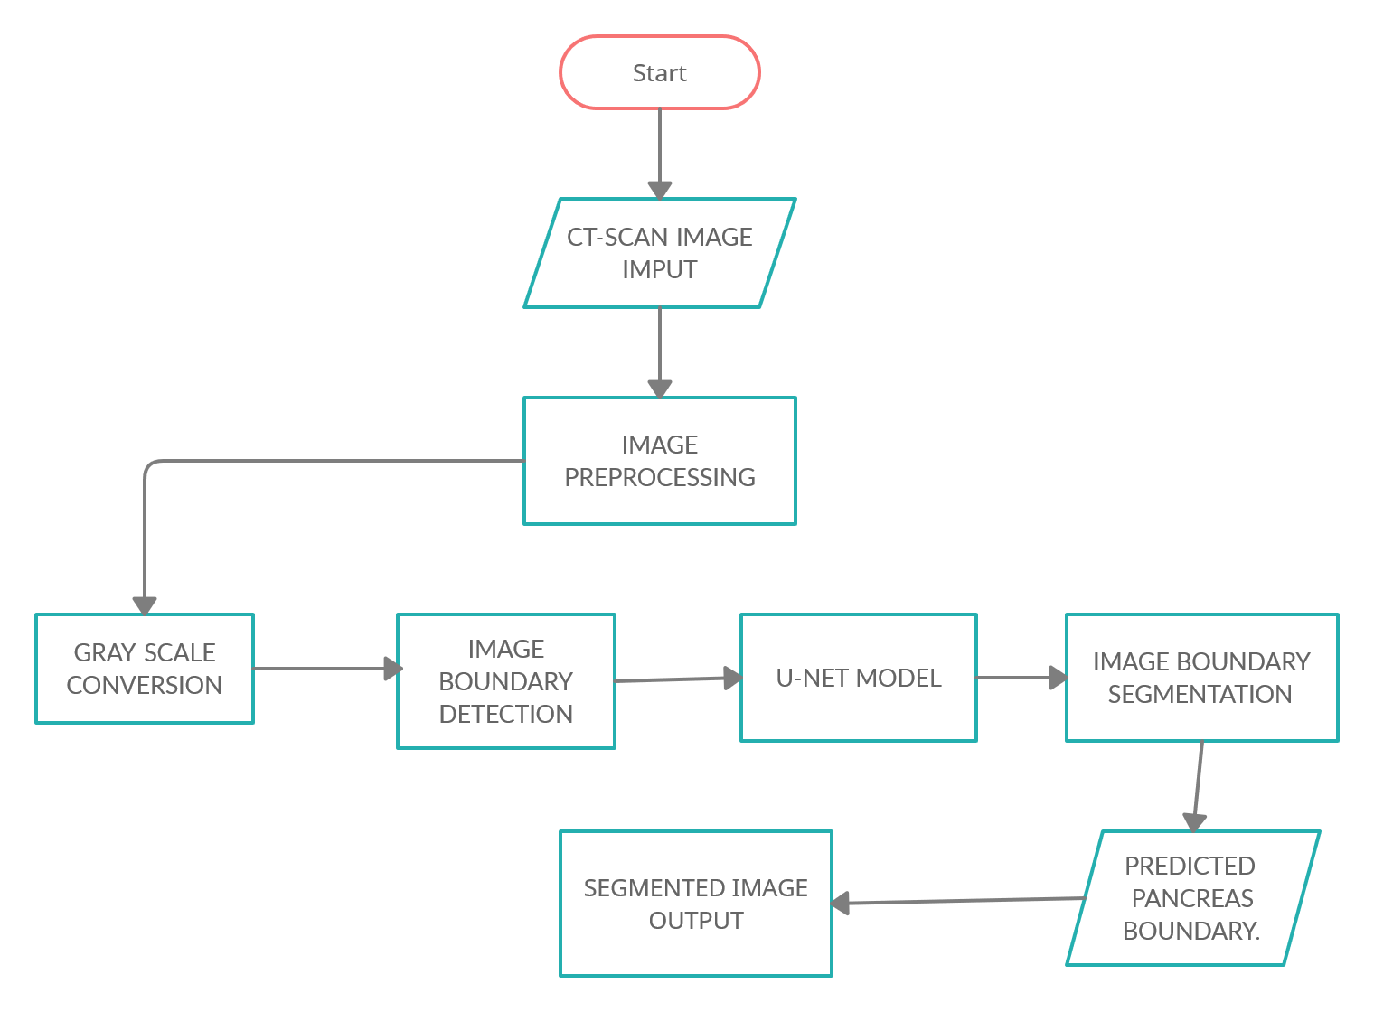
Architecture diagram:

Slide 14
LIST OF MODULES
DATASETS PREPARATION.
IMAGE PRE-PROCESSING AND VISUALISATION INITIALIZATION.
CONSTRUCTING UNET MODEL AND TRAINING IT.
SEGMENTATION - VISUALISATION OF OUTPUT.

Slide 15
MODULE 1: DATASETS PREPARATION.
Raw data image is collected from the internet and other data sources without license.
The collected CT Scans are segregated into folders namely, train, test, validate [ 4:1:1 ].
Each data is named and annotated in the sequential order.
Folder is moved into the root directory and prepared for image pre-processing.

Slide 16
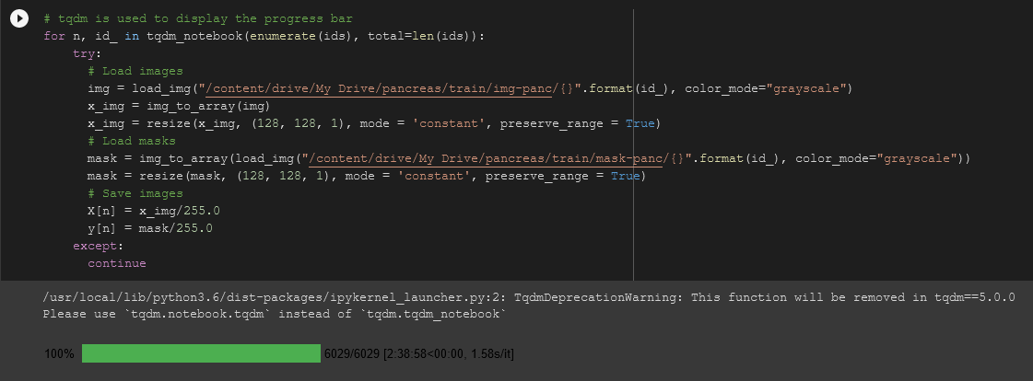
DATASETS PREPARATION.

Slide 17
MODULE 2: IMAGE PRE-PROCESSING AND VISUALISATION INITIALIZATION.
Images in the dataset are resized into similar dimensions and stored in the respective folders.
The images are converted into a 1-D array using NumPy module for sophisticated image processing.
The sample image is viewed and respective mask image is displayed. The same process is iterated to all the images in the dataset and the progress is displayed using a “tqdm” bar.
The entire dataset is split into testing and training dataset folders.

Slide 18
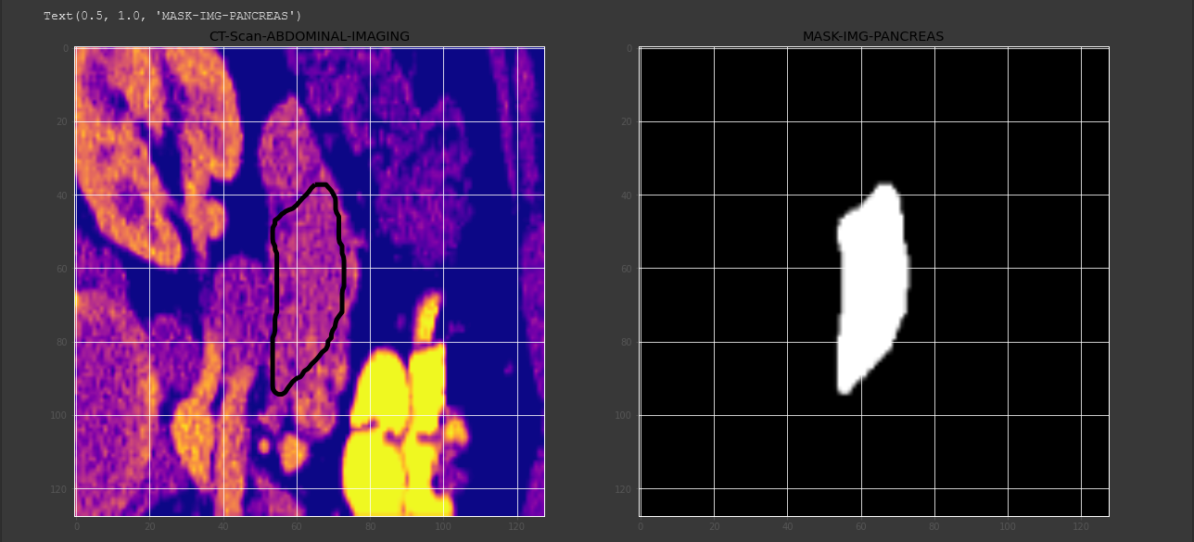
IMAGE PRE-PROCESSING AND VISUALISATION OUTPUT:

Slide 19
MODULE 3: CONSTRUCTING UNET MODEL AND TRAINING IT.
A static 2-D convolutional block is created with “relu” activation function, and its function is to add 2 convolutional layers with parameters passed to it.
A nine layer U-NET architecture model is developed with the 2-D convolutional block function created before.
The first four layers are used as Contraction path and the last four layers are used for Expansive path.
The model is trained with 50 Epochs with specific condition to exit if the accuracy of the model does not improve over a period of time.
The final model is saved and reloaded into the script for testing and output visualization.

Slide 20
MODULE 4: SEGMENTATION - VISUALISATION OF OUTPUT.
The trained model’s loss and validation loss is plotted in a 2-D graph chart.
The threshold predictions on the test and validation dataset is processed and completed.
A final function to plot the data and to check the prediction is developed.
The segmented images is displayed in 4 different visualization models [ Seismic, normal, border prediction, and binary model ].
The final segmentation of the pancreas from the abdominal CT Scan is displayed as the resultant output.

Slide 21
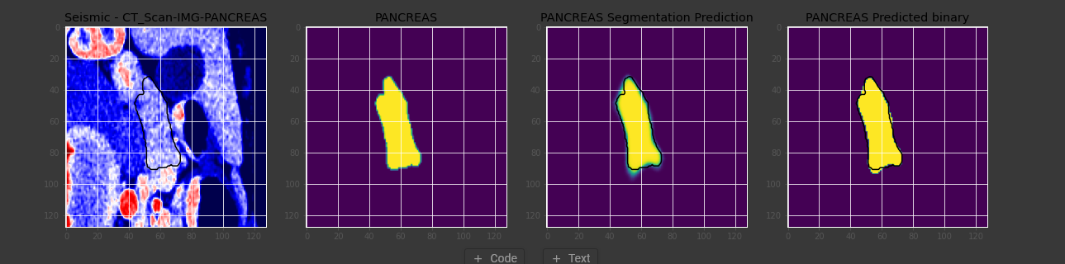
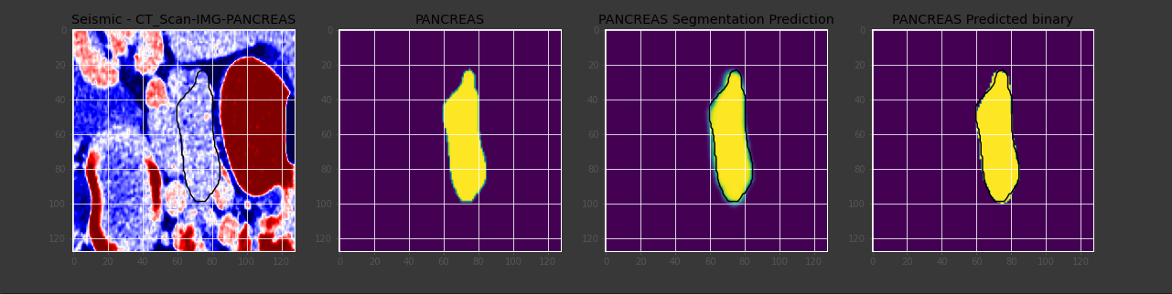
SEGMENTATION - VISUALISATION OF OUTPUT:

Slide 22
Thank you

